Slide 1


Labs India Pvt ltd

Slide 2


It’s not Sap
It’s S.A.P

Slide 3
INTRODUCTION
Systems , applications and products
Founded in November 1998
S.A.P Labs India is S.A.P's largest Research and Development center outside its headquarters in Germany
It is one of the earliest R&D centers of a global company to have a footprint in Bangalore

Slide 4

What does S.A.P labs do?
Build software
Maintain software
research

Slide 5
Work culture in sap labs
S.A.P Labs has 7500 employees spread across its three development centers in India
Absence of sir-ma’am culture give special freedom and space to employees
Care for life fund
Breakfast with Bosses
Work from home for four days in a month
Glassdoor Rating: 4.1/5

Slide 6
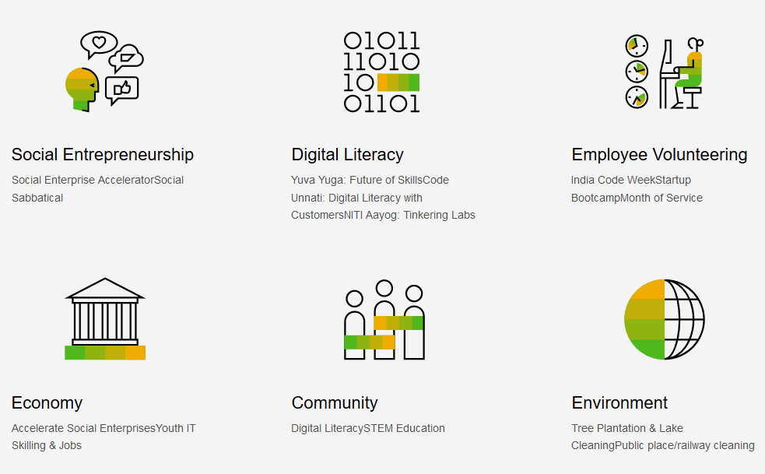
Corporate Social Responsibility

Slide 7

Sap labs India is located in
Bangalore
Gurgaon
Pune

Slide 8



ud, and Managing Director, SAP Labs India
SAP Labs India Management Team
Dilipkumar Khandelwal
- President, SAP HANA Enterprise Cloud, SAP Labs IndiaKhandelwal
Mahesh Nayak
- Chief Operating Officer, SAP Labs India
Shraddhanjali Rao
-Head-HR, SAP, India

Slide 9
Thank You

